Slide 1





The company includes a wide range of local and global expertise that will be provided to achieve the desired impact of the project.*
Mohannad Fahd Al-Mushari
Rana Khalil
Mohamed Adnan interrogator
Najeeb Nasser
Data Analyst
Quality Management Consultant
Business Continuity and Cybersecurity Consultant
Enterprise Architecture Specialist
Ramzi Ahmed
Anas Nabulsi
Technical Asset Management Specialist
SpecialistITIL
*In addition to12Available human resources in the organization as mentioned in the appendix.KAPT-DI-ITSM-RFPClause 7.2They will be recruited to work within the scope of the project.ComprehensiveCIO, CTO

Slide 2
Project timeline
Fourth year |  |  |  | The third year |  |  |  | Second year |  |  |  | First year |  |  |  | The year
The fourth quarter | Third quarter | Second quarter | The first quarter | The fourth quarter | Third quarter | Second quarter | First quarter | Fourth quarter | Third quarter | The second quarter | The first quarter | Fourth quarter | The third quarter | Second quarter | First Quarter | The stage
 |  |  |  |  |  |  |  |  |  |  |  |  |  |  |  | Evaluation
 |  |  |  |  |  |  |  |  |  |  |  |  |  |  |  | Operation
 |  |  |  |  |  |  |  |  |  |  |  |  |  |  |  | Delivery
On-the-job guidance
The stages, outputs, and associated tasks were detailed in the scope of the technical proposal.

Slide 3


Executive Summary
Scope of Work of the Project
MethodologyProject implementation
Project implementation schedule
The organizational structure and the team.
Project Assumptions
About Digital Future Company
Our customers
Our Projects
3

Slide 4
Scope of Work
The Royal Commission for Riyadh City seeks to appoint a consultancy to undertake the task of identifying the requirements for providing IT service management and renewing licenses for the King Abdul Aziz Public Transport Project in Riyadh for a duration of 4 years through 4 work packages.
Package 2: Improvement and IntegrationITIL Through an organizationITSM
Implementation of principlesITILInside the organizationITSMForTCC,Focusing on delivering value, alignment, and continuous improvement. It includes iterative enhancements through change management, service catalog, and incident and problem management.
Package 1: Data Center MaturityTCC
Including the improvement of the data center environment through strategic initiatives, including business engineering, business continuity, and information security consulting.
Package 4: Licenses and Subscriptions
It aims to simplify procurement processes and unify annual renewals for 4 years.
Package 3: Maturity of IT Service Management Service inTCC
Information technology infrastructure management, system operations, governance, email, domain services, and information security interface
* During the Q&A session, we were informed that the document announced on the Etimad platform is not final and that Package No. 5 related to disaster recovery management has been canceled.

Slide 5
Executive Summary
Scope of Work for the Project
Project Implementation Methodology
Project Implementation Timeline
Organizational Structure and Team
Project Assumptions
About Digital Future Company
Our clients
Our Projects
5

Slide 6

We propose that this project be implemented through a methodology consisting of 3 phases, which will be applied by following tried and proven mechanisms for each phase...
Delivery
Operation
Evaluation
The deliverables and all project-related documents will be delivered, and the project closure phase will be implemented according to global best practices in project management.
Operations and policies will be implemented according to best practices and international standards, and their performance will be monitored. Periodic reports will be issued and the efficiency of the Authority's staff will be developed through workshops and on-the-job training.
The IT services management will be evaluated inTCCIn terms of policies, processes, and tools used, and providing a comprehensive document with recommendations.

Slide 7




We have linked the main requirements and outputs related to the project according to the specification document.
Details of tasks and outputs
Outputs
The stage
The package
Evaluation of the current processes and policies followed in the entity by studying and analyzing the existing roles, responsibilities, and documents, monitoring the mechanism, tracking issuance, analyzing risks, and providing a comprehensive document with recommendations and a roadmap.
Comprehensive Gap Analysis Report According to ISO 27001 and 9001 Standards
Providing a unified risk assessment at the enterprise level against ISO 27001 and 9001 controls.
Assessment
Package 1: Data Center MaturityTCC
Based on the evaluation phase outcomes, the schedule and necessary plans will be prepared.
Improving process design and policies according to the recommendations document from the evaluation phase.
Performance monitoring through audit sessions and issuing periodic reports and analyzing them to refine future plans.
Coordinating with ISO certification bodies to conduct external audits and grant certificates to the organizationISO 9001AndISO 27001
Timeline and Deliverables Plan
Periodic reports on achievements and priorities
Monthly Resources and Training Plan
Providing information security policies, procedures, and controls in accordance with ISO 27001, and quality management procedures and controls in accordance with ISO 9001.
Providing performance indicators for ISO 27001
Providing licensing and delivery within an environmentTCCCompatible tool withTOGAF Meet the infrastructure requirements of the organization and business services.
The financing model for the second, third, fourth, and fifth years with an enhanced structure in a compatible tool.TOGAF
Operation

Slide 8
We linked the main requirements and outputs related to the project according to the terms of reference and specifications.
Detailing tasks and outputs
Outputs
Stage
The package
Evaluation of the current processes and policies followed in the authority by studying and analyzing current roles, responsibilities, and documents, monitoring the mechanism, following up on issuance, analyzing risks, and providing a comprehensive document with recommendations and a roadmap.
Comprehensive Gap Analysis Report According to ISO 20000 Standard
Evaluation
Package 2: Improvement and IntegrationITILThrough an organizationITSM
Based on the outcomes of the evaluation phase, the schedule and necessary plans will be prepared.
Improving process design and policies according to the recommendations document from the evaluation phase.
Monitoring performance through auditing sessions, issuing periodic reports, and analyzing them to refine future plans.
Timeline and Deliverables Plan
Periodic reports on achievements and priorities
Monthly Resources and Training Plan
Implementation of change management, incident, problem, and service catalog operations
Issuing special reports
Operation

Slide 9
We have linked the main requirements and outputs related to the project according to the terms and specifications document.
Detailing tasks and outputs
Outputs
The stage
The package
Package 3: Maturity of IT Service Management Service inTCC
Operating the services listed by a specialized and experienced team in the required fields.
Issuing periodic reports and improvement plans
Alignment on plans with stakeholders
Implementing improvement plans and reviewing the achieved impact
Information Technology Infrastructure Management
Operating Information Technology Systems
IT Governance
Creating and Managing Email and Calendar Services
Domain Services Management
Cybersecurity Interface
Monthly Resource Plan
Monthly Guide to Time and Compliance Records
Monthly System Performance Report
Quarterly Plan for System Improvement and Recommendations
Annual Timeline for Product Delivery
Annual Document Update for Operation and Maintenance
Annual Training and Development Plan and Compliance
Operation

Slide 10
We linked the main requirements and project outputs according to the terms and specifications booklet.
Detailing tasks and outputs
Outputs
The stage
The package
Package 4: Licenses and Subscriptions
Providing the required licenses and subscriptions according to the booklet.
Liferay DXP
Liferay Search
SolarWinds NPM - Enterprise Edition
AndroidAndroidتطبيق أصلي للهواتف المحمولة
iOS Native mobile app
SOAP UI Pro
App Dynamics - Enterprise Edition
Burp SuiteWeb & mobile
Commvault
RHEL Premium
Nextcloudالدعم المتميز
F5 ASM
F5 LTM
ITSM IFS
Atlassian Jira
Firebase
Google Maps API
Google Places API
Operation

Slide 11
We have linked the key requirements and project-related outputs according to the terms and specifications booklet.
Detailing of tasks and outputs
Outputs
The stage
The package
Conducting specialized training workshops
Conduct knowledge transfer sessions to deliver outputs
Preparing a Project Closure Report
A 4-year training program to develop competencies
Delivery
All packages

Slide 12
The project will be implemented by a specialized team.
Package 2: Improvement and IntegrationITIL Through an organizationIT Service Management
SpecialistITIL
Package 1: Data Center MaturityTCC
Enterprise Architecture Specialist
Business Continuity and Cybersecurity Consultant (Saudi National)
Quality Management Consultant (Saudi National)
Business Analyst
Digital Services Consultant
Package 3: Maturity of IT Service ManagementTCC
IT Operations ManagerOT
IT Infrastructure Engineer
Network and Cybersecurity Engineer
Network engineer andVOIP
Systems Engineer
Linux System Administrator/Oracle Database Manager
Technical Asset Management Specialist
Senior Project Management Office Specialist (Saudi nationality)
Project Specialist (Saudi nationality) - 2 positions

Slide 13
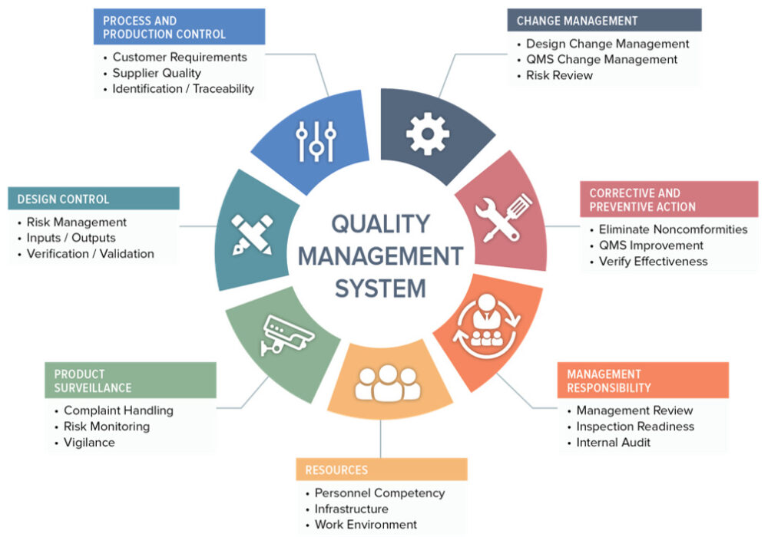
We will implement the quality management system according to ISO 9001 standards.
We will doEnsuring provisionCommitment and Leadership Support To ensure quality enhancement and provision of the required resourcesPlease provide the Arabic text you would like translated.
We will define the scope of the quality management system. To cover the relevant products and services.I'm sorry, but it appears there is no text provided for translation.
We will analyze the current situation. To identify the gaps between the current system and the requirements.ISO 9001.
We will develop the quality policy and quality objectives. That align with the goalsThe AuthorityI'm sorry, but it seems like the text you provided is missing. Please provide the text you would like translated.
We will prepare the documents and procedures. Which include the quality manual, work procedures, and quality records.I'm sorry, but it seems that the text you submitted is missing or not visible. Could you please provide the Arabic text that you need translated?
We will implement the procedures. To ensure compliance with requirementsISO 9001.
We will train the employees. To enable them to apply the standards and understand their role in achieving the objectives.Please provide the text you would like translated.
We will conduct the internal reviews. RegularlyTo ensure the effectiveness of the quality management systemI'm sorry, but there is no text provided for translation. Please provide the text you would like translated.
We will prepare for the external review. To obtain the certificationI'm sorry, there's no text provided for translation. Please provide the Arabic text you would like translated.
We will strive to achieveContinuous Improvement Through periodic reviews and performance analysisSure, I can help with that. Please provide the text you would like translated from Arabic to English.

Slide 14
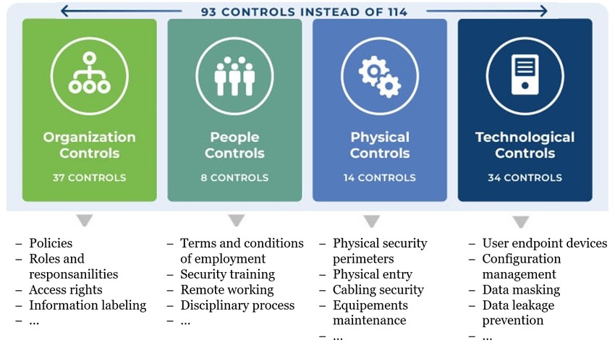
We will also implement an information security management system in accordance with ISO 27001 standards.
The application of the standard will help the authority in:
Protection of the confidentiality, integrity, and availability of information.
Reducing security risks and ensuring business continuity.
Compliance with local and global data protection laws and regulations.
Application steps include:
Identifying informational assets and risk assessment.
Implement appropriate protection measures.
System monitoring and periodic improvement.

Slide 15
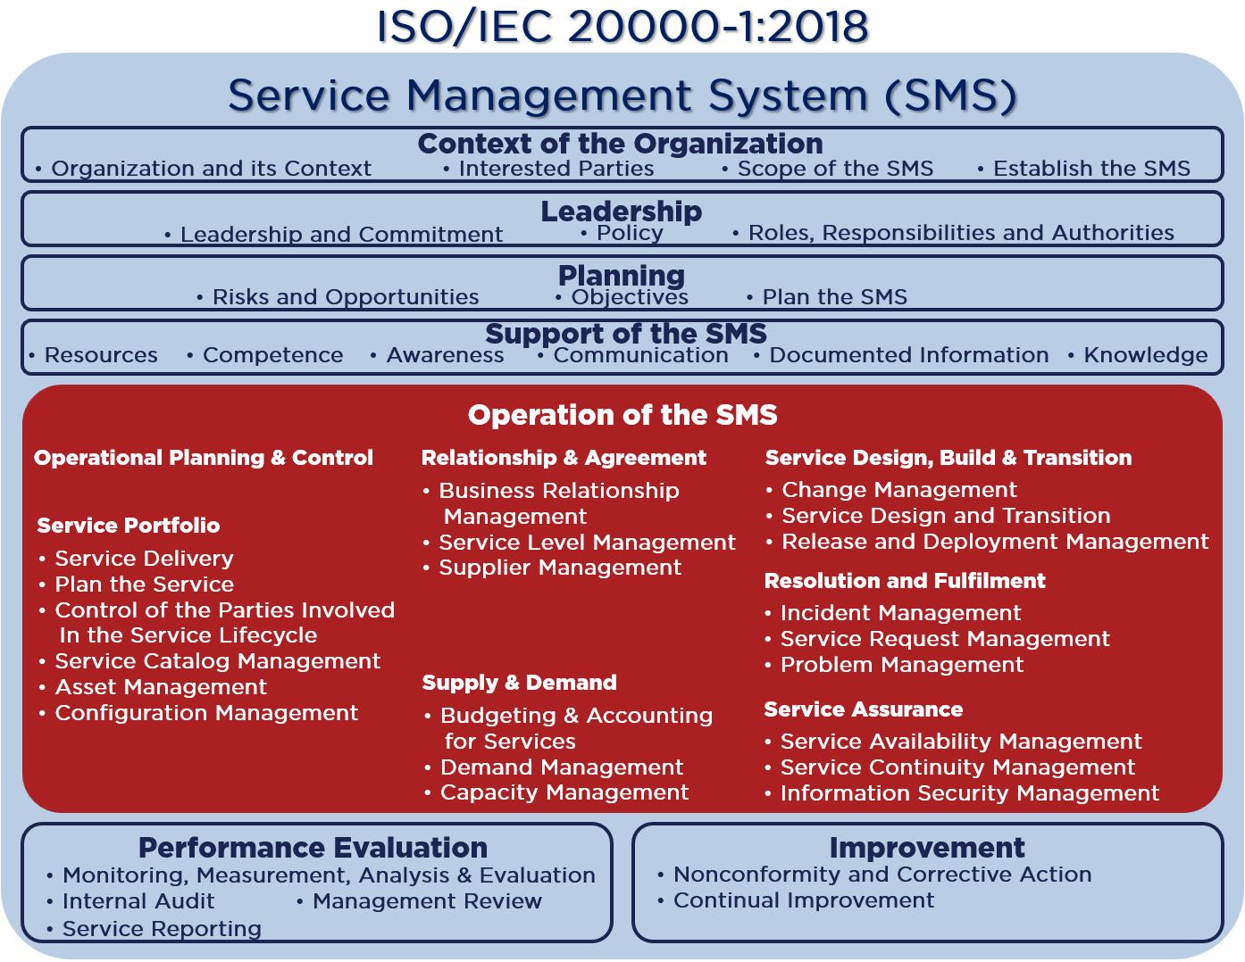
We will also implement an IT service management system in accordance with ISO 20000 standards.
The implementation of the standard will help the authority to:
Improving the quality of servicesEnsuring that the provided services meet customer requirements.
Increasing efficiencyImproving internal processes and increasing the effectiveness of IT service management.
Compliance with standardsCompliance with the required regulations and industry standards.
Improving customer satisfaction: By providing services characterized by reliability and continuity.
Application steps include:
Analysis of the current situation of servicesDetermining the necessary improvements.
Implementing appropriate procedures for service managementAccording to the requirementsISO 20000.
Performance monitoring and reviewTo ensure continuous improvement

Slide 16
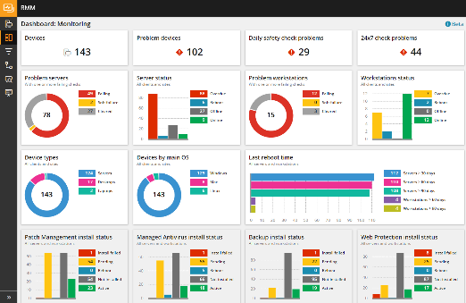
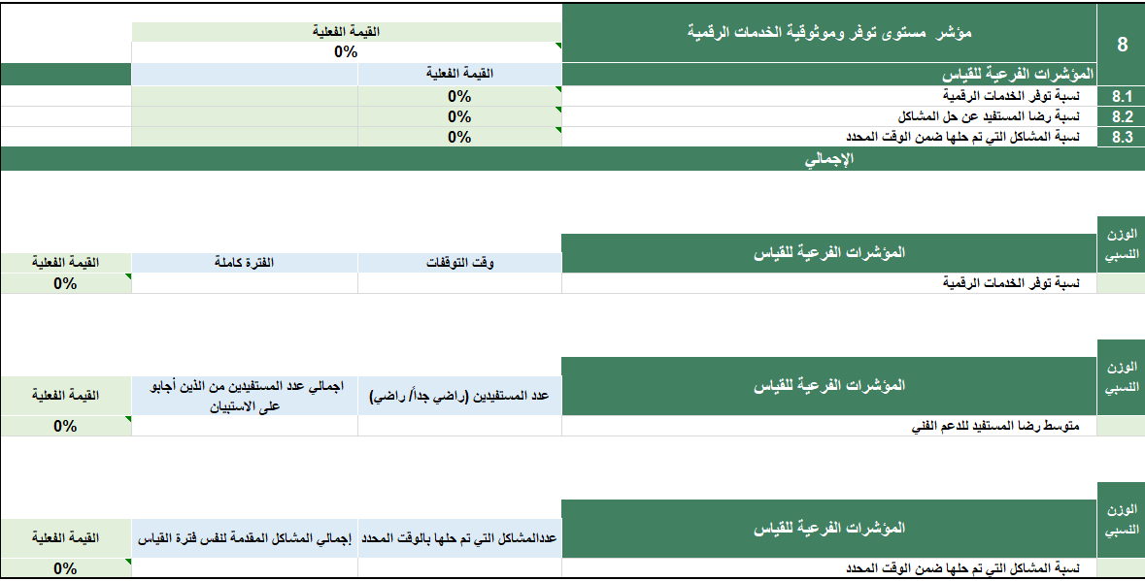
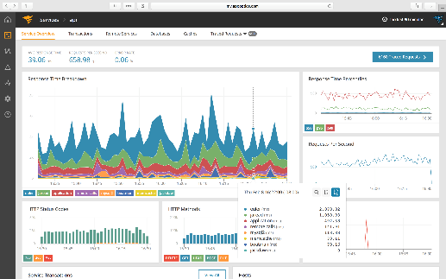
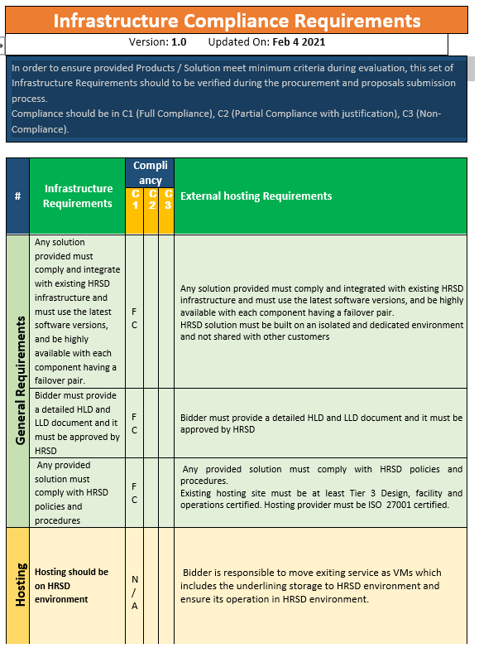
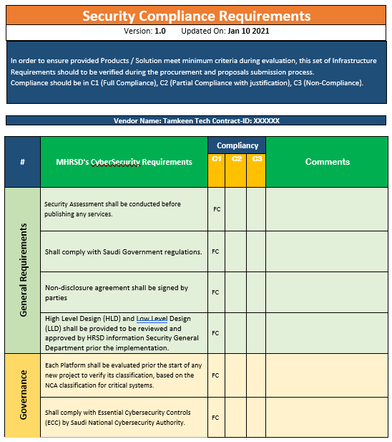
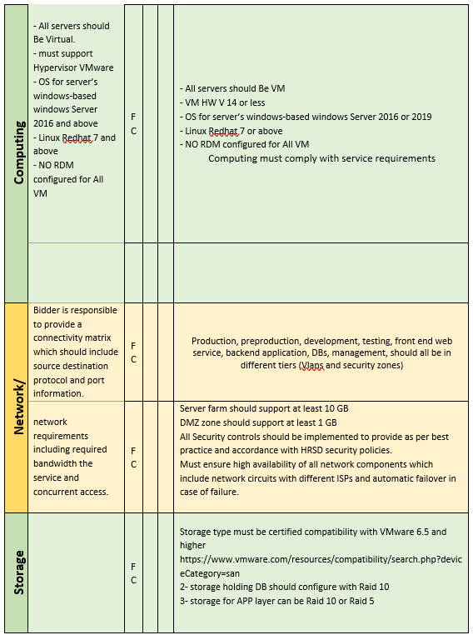
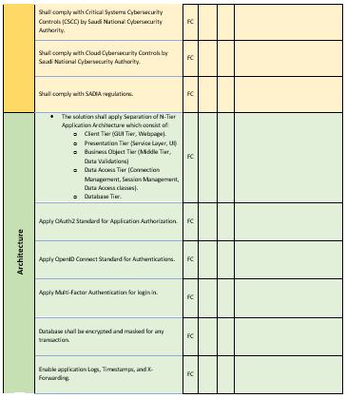
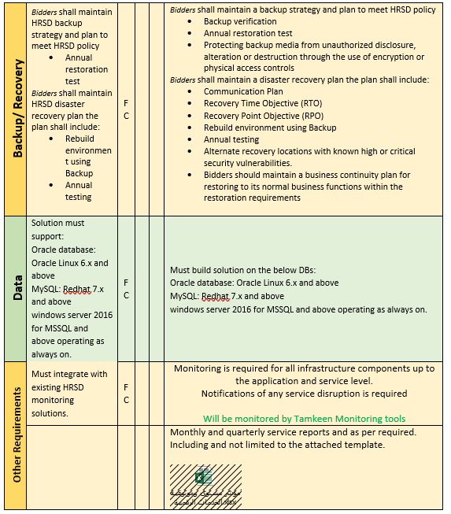
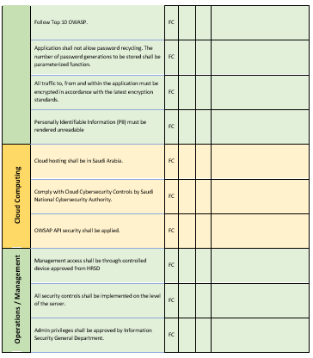
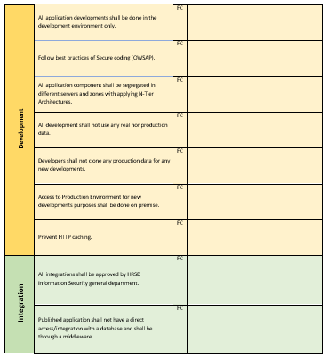
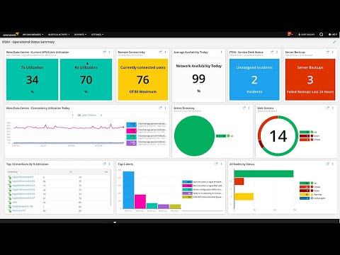
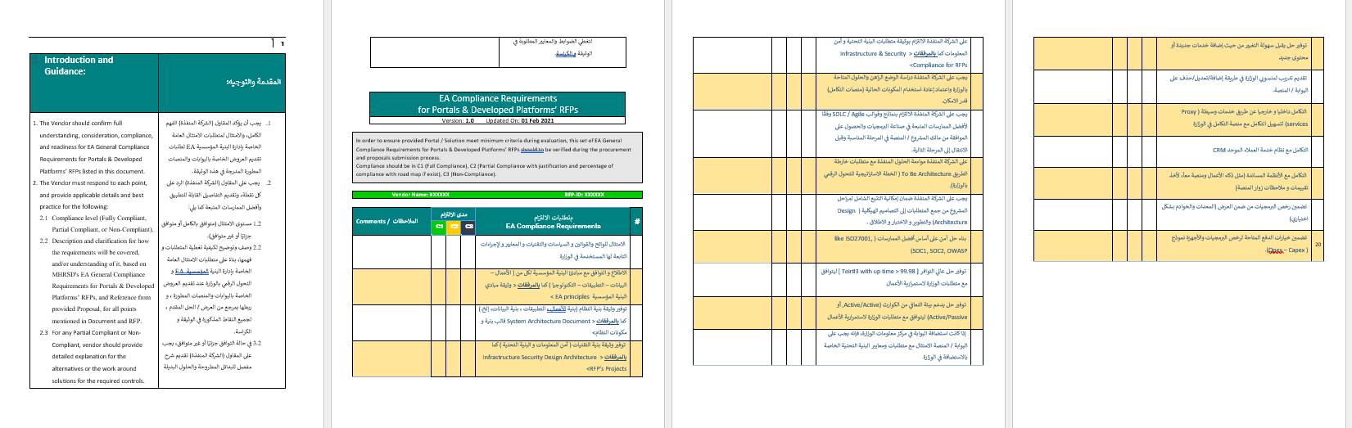
We will also operate the technical systems according to the best practices and global standards.
Support tools for cloud infrastructure monitoring
Tools and methodologies used in governance
And we will use a set Methodologies and tools for monitoring performance indicators to ensure reliability and availability.
Illustrative example
Illustrative example

Slide 17

Periodic reports will also be issued to monitor the progress of work.
Report frequency
Report description
Report Name
Quarterly
A report outlining the status of deliveries based on their schedule.
The timeline and delivery plan
Weekly
A report outlining the priority tasks and their potential risks.
Priorities and Risks
Monthly
A report detailing the names and roles of human resources for the upcoming period
Human Resources Plan
Monthly
Report showing the commitment of human resources for the current period to working hours
Human Resources Work Schedule
Monthly
Report on Task Completion Status
Workflow
Quarterly
Report on the Status of Training Sessions
Training Plan

Slide 18
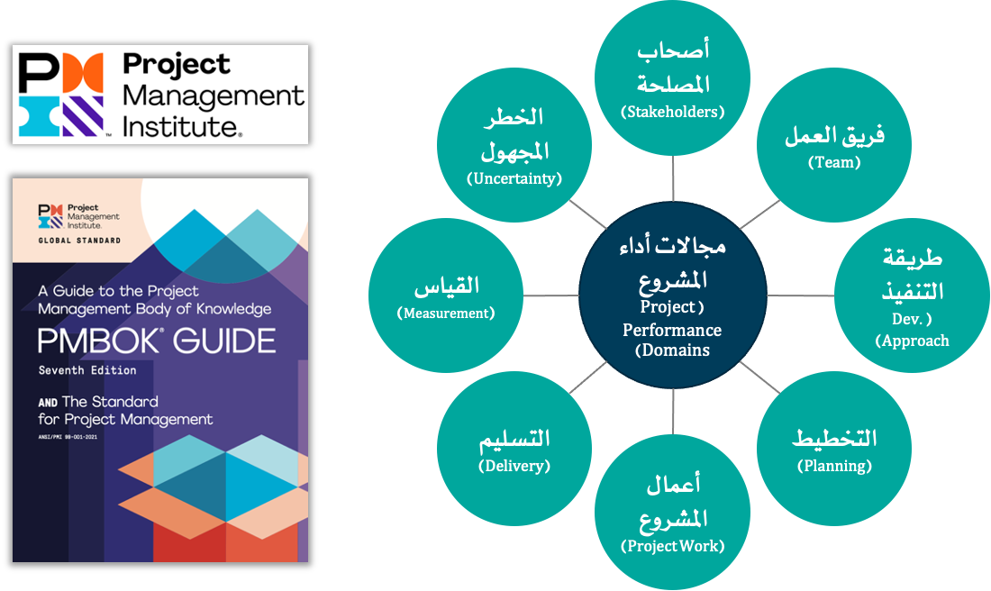
Project Implementation Methodology - Project Management Methodology
The methodology adopted for managing consultancy and technical projects related to the company is based on the latest edition (seventh edition) of the project management methodology.PMBOK) Issued by the Project Management Institute (PMI). Where methodology (PMBOK(It is the globally prevailing methodology in project management, and in its seventh edition, eight project performance domains were adopted.)Project Performance Domains) They are essential groups for all types of projects linked to each other. When managing any project, a number of processes/methodologies must be selected. (Methods) and tools (مُقتنيات أثرية) Supporting and influencing all eight areas of project performance.
Unknown Risks
Stakeholders
Measurement
The team
Project performance areas
Delivery
Method of execution
Project Works
Planning

Slide 19

Project Implementation Methodology – Proposed Workflow for Project Execution According to Project Management Methodology
In accordance with the project management methodology issued by the Project Management Institute.PMIBased on our previous experience in this type of consulting projectsTechnologyAnd work experience inSimilar projectsIn the Kingdom of Saudi Arabia, in accordance with the nature of the project we will undertake, the work on this project will proceed according to the following workflow:
Monitoring and control
Monitoring project activities /Monitoring project costs, budget, and performance indicators / Problem management / Risk management / Taking corrective actions
End of the project
Project implementation
Project planning
Start of the project
Project completion
Delivery of documents and papers
Documenting Lessons Learned
Termination of the contract
Project team formation
Executing project tasks
Project Output Management
Quality Management
Developing the action plan, including resources and the mechanism for work division
Developing a Communication Plan
Develop risk management plans
Project Governance and Management
Project Start Presentation
Project Charter Development
Defining the scope of work in the project
Identifying potential risks
Establishing special protocols for the project

Slide 20
Project Implementation Methodology - Proposed Workflow for Project Execution - Project Initiation Phase
Objectives
Tasks
Defining and approving project management mechanisms, and having them approved by the supervising authorities of the project.
Defining and approving the project governance framework and the frequency of project implementation follow-up meetings.
Proactivity in managing risks that the project may face.
Developing a project management methodology in accordance with the client's approved methodology to ensure systematic project governance, with at least the following basic components identified:
Project DocumentProject Charter).
Scope of Work DocumentProject Scope of Work).
Communication Plan Document (Communication Plan).
Risk Management DocumentRisk Management PlanThe text provided does not contain any Arabic words or phrases to translate to English.
Problem Management DocumentIssues Management Plan).
Identifying the key stakeholders in the projectProject StakeholdersThey must participate in the project to accomplish the outputs and tasks related to the project.
Specify the project team (from the company and the client) and define the responsibilities and authorities of the teams.
Defining the project governance frameworkProject Governance FrameworkDefining the project's steering committees, their powers, and the cycle of meetings for monitoring the project's implementation.
Credits
The entity supervising the project to review the proposals and work jointly with the advisory team to reach the final version of the project governance framework.
The supervising authority of the project relies on project governance and management documents.
Outputs
Project Management DocumentsProject Charter, Risk Management Plan, etc.).
Project Governance FrameworkProject Governance Framework).

